Slide 1

EXST 7142 Group Project
Predicting Salary Using UCI Adult Dataset
Taniya Sultana
Group Members:
Saiful
Magesh
October, 2022

Slide 2
Motivation and Source of Dataset
Motivation
Two tentative datasets
Car Evaluation Dataset
Adult Dataset
Interested to explore the demographic characteristics which can help to predict the probability of making more than 50k annually
Adult Dataset was chosen
Source
1994 Census database
UCI machine learning repository
dim(adult) 32561 15

Slide 3
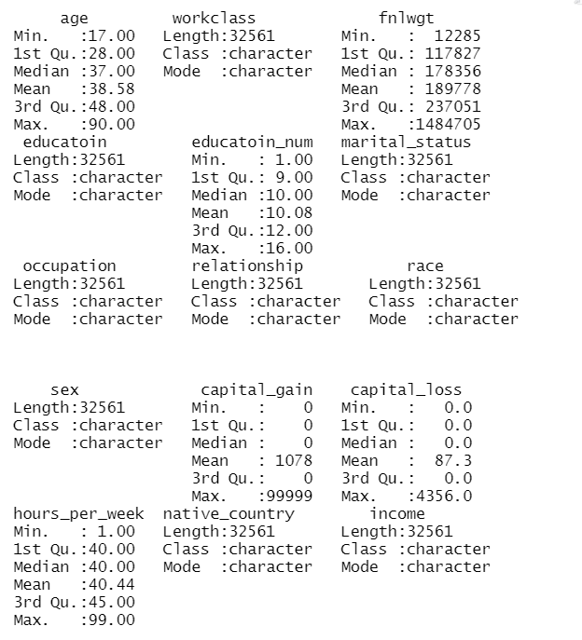
Data Description
Work class: Types of employees
Private, government etc.
Fnlwgt: Number of people represented by the observation
Education and education num: represents similar variable
Preschool = 1, HS-grad = 9, Bachelor =13
Relationship: How they relate to others
Husband, wife, not-in family etc.
Income: If individuals make
<=50k
>50k
1836
1843
583

Slide 4
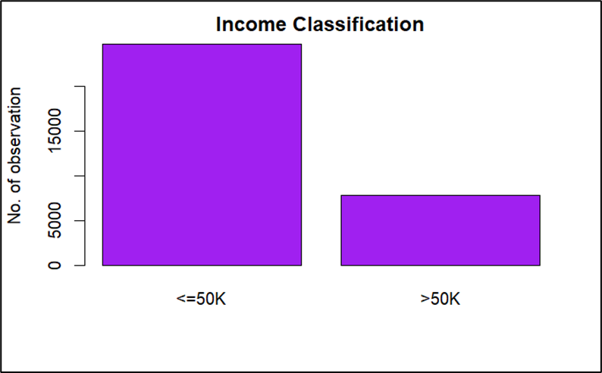
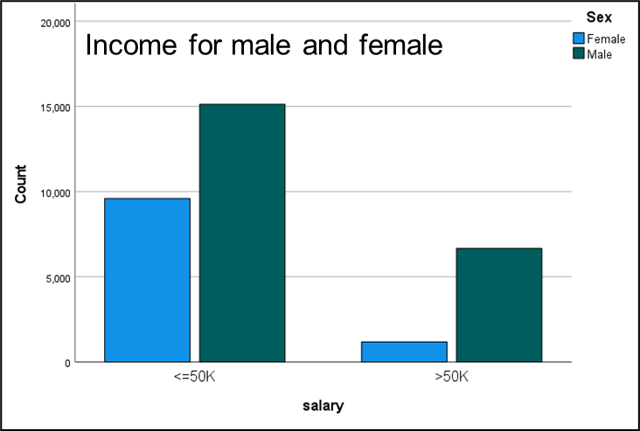
Exploring the Data
75.91% observations had income <=50k and
24.1% observations had income >50k
Females are underrepresented in terms of earning >50k annually.

Slide 5
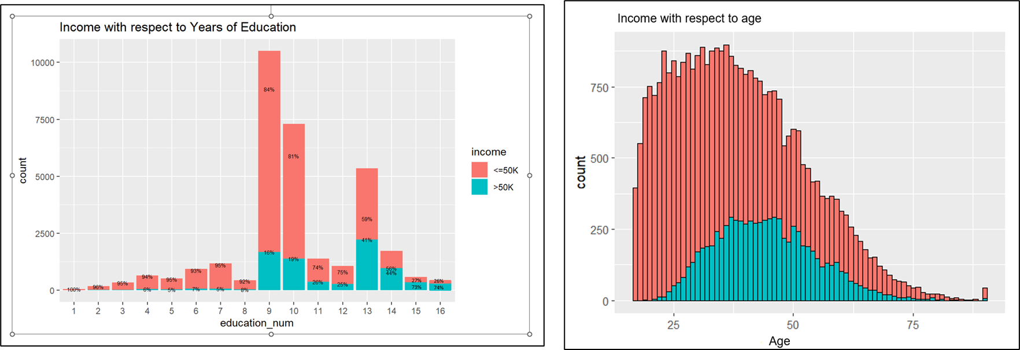

Exploring the Data
Proportion is increasing with the increase of education. Education with less than 9 have less than 10% individual with income greater than 50k
Proportion is higher around mid-career

Slide 6
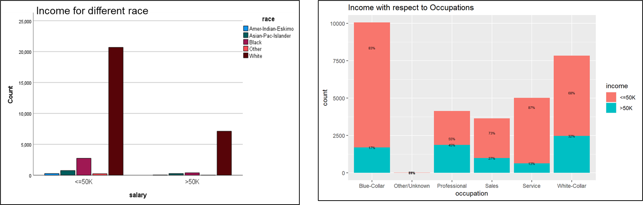
Exploring the Data
Income variation is higher across different occupations. Almost half of Professional occupation have greater than $50,000 a year, while less than 20% for Service occupation and blue collar.
White people are the majority with more than 50k

Slide 7
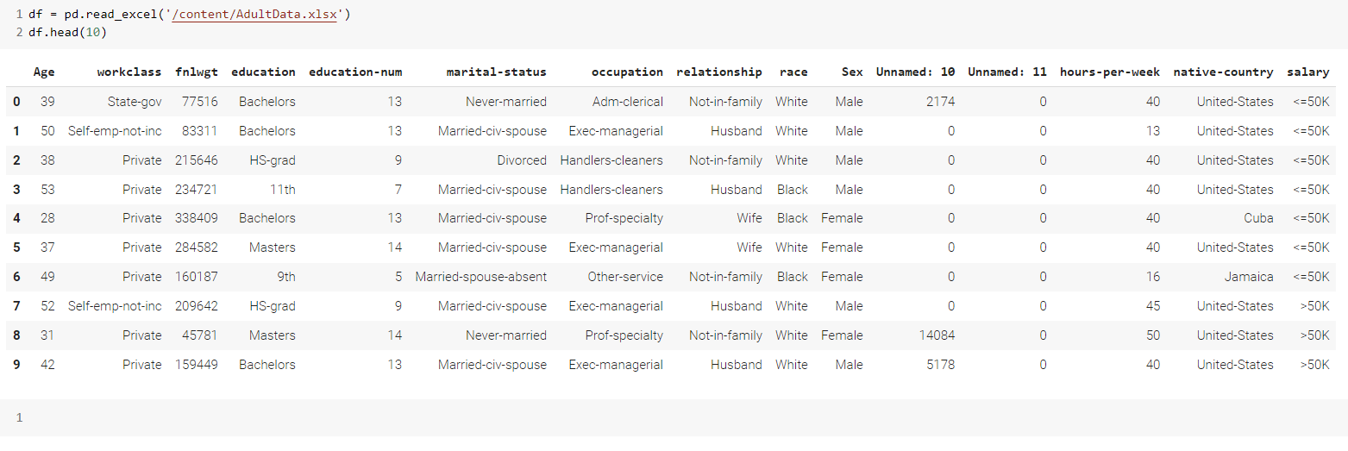
Data Cleaning
Initial dataframe structure

Slide 8
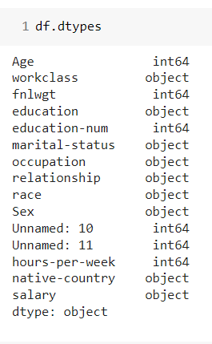
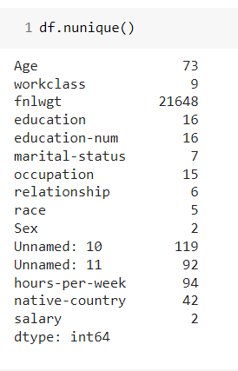
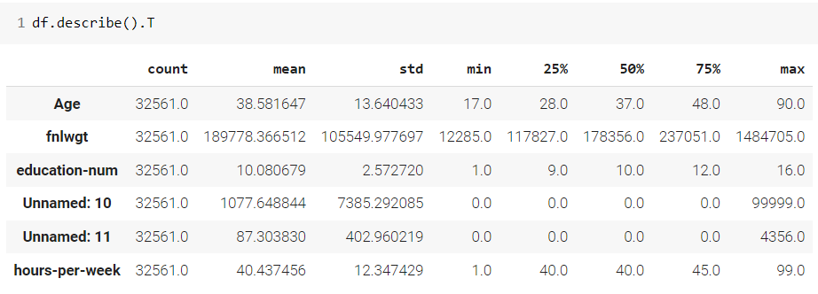
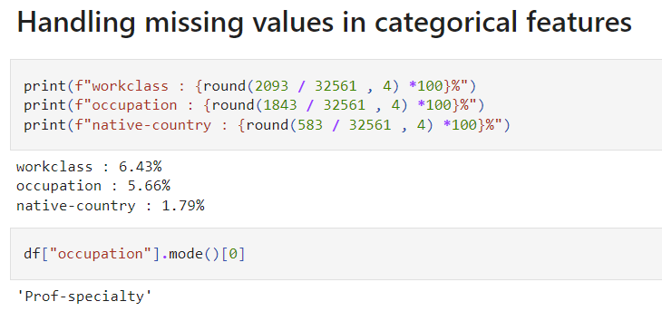
Data Cleaning
Description of the data in the DataFrame

Slide 9
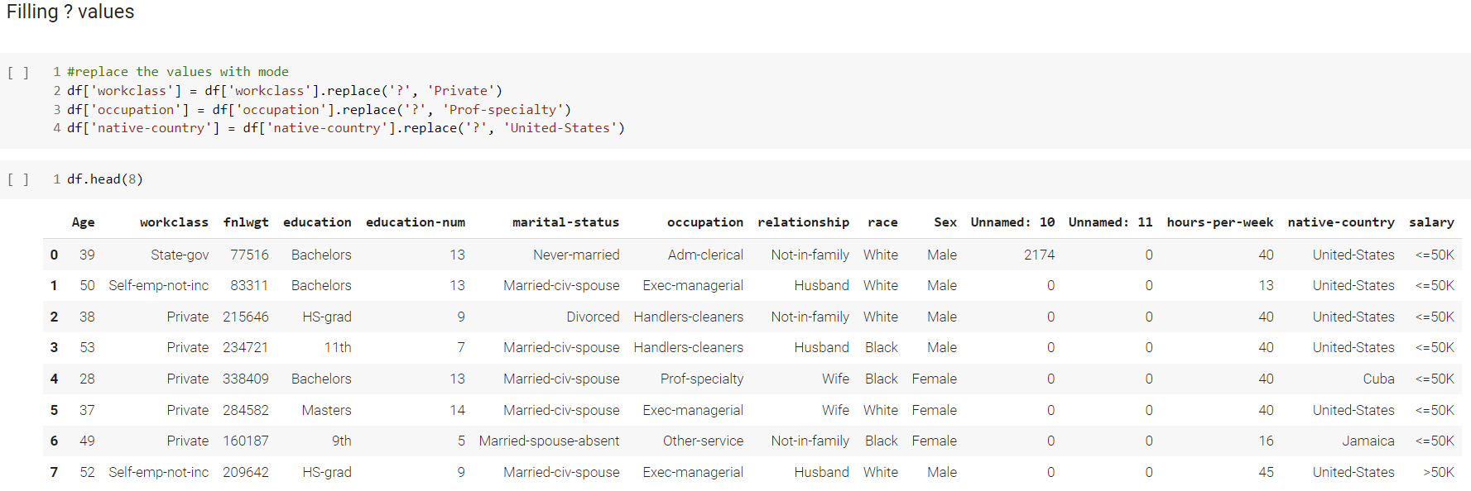
Data Cleaning
(Replacing Missing Values with their mode)

Slide 10
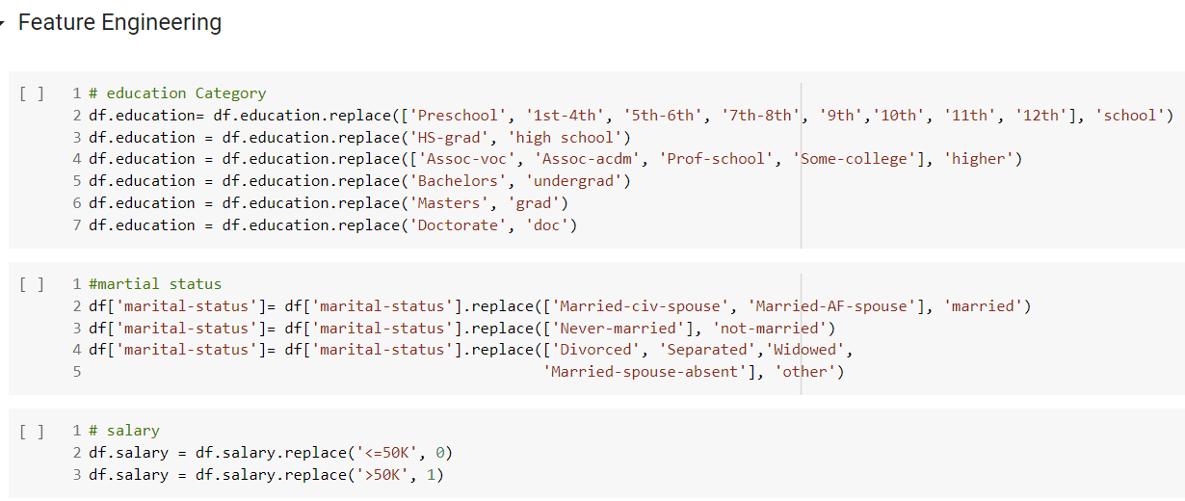
Data Cleaning

Slide 11
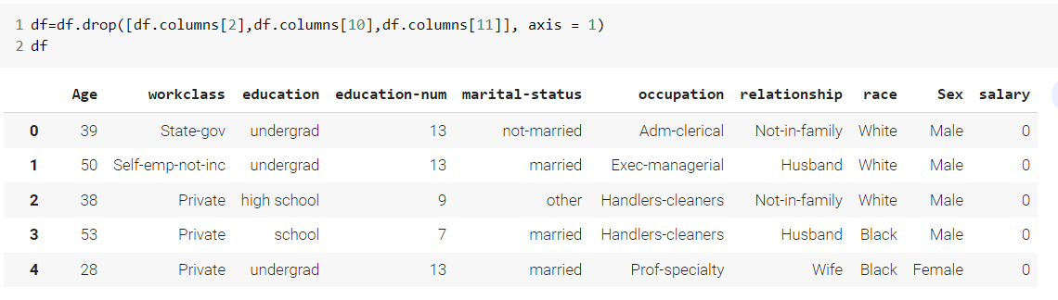
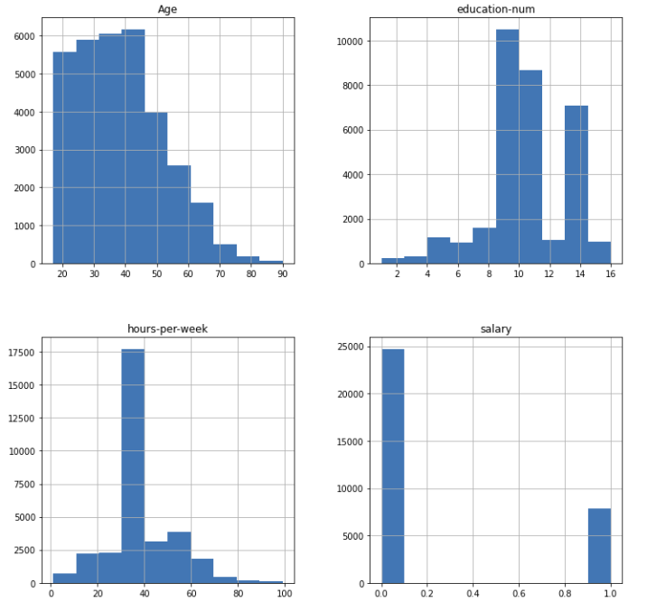
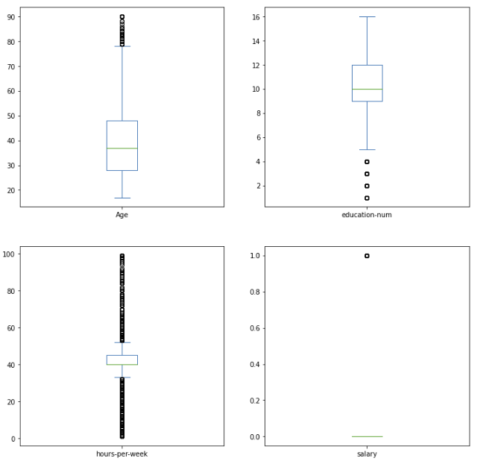
Data Cleaning
Final Data Frame After Cleaning
Histogram
BoxPlot

Slide 12
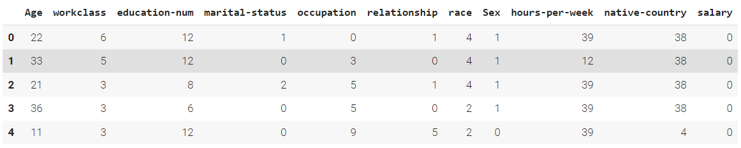
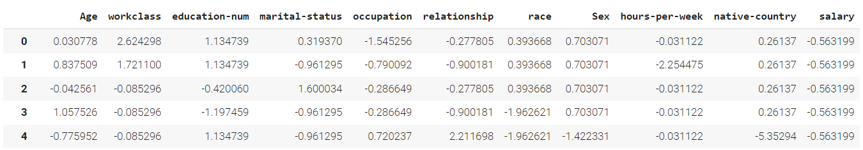
Data Cleaning
Label Encoding refers to converting the labels into a numeric form so as to convert them into the machine-readable form
Standard Scaler standardizes a feature by subtracting the mean and then scales to unit variance. Unit variance means dividing all the values by the standard deviation.

Slide 13
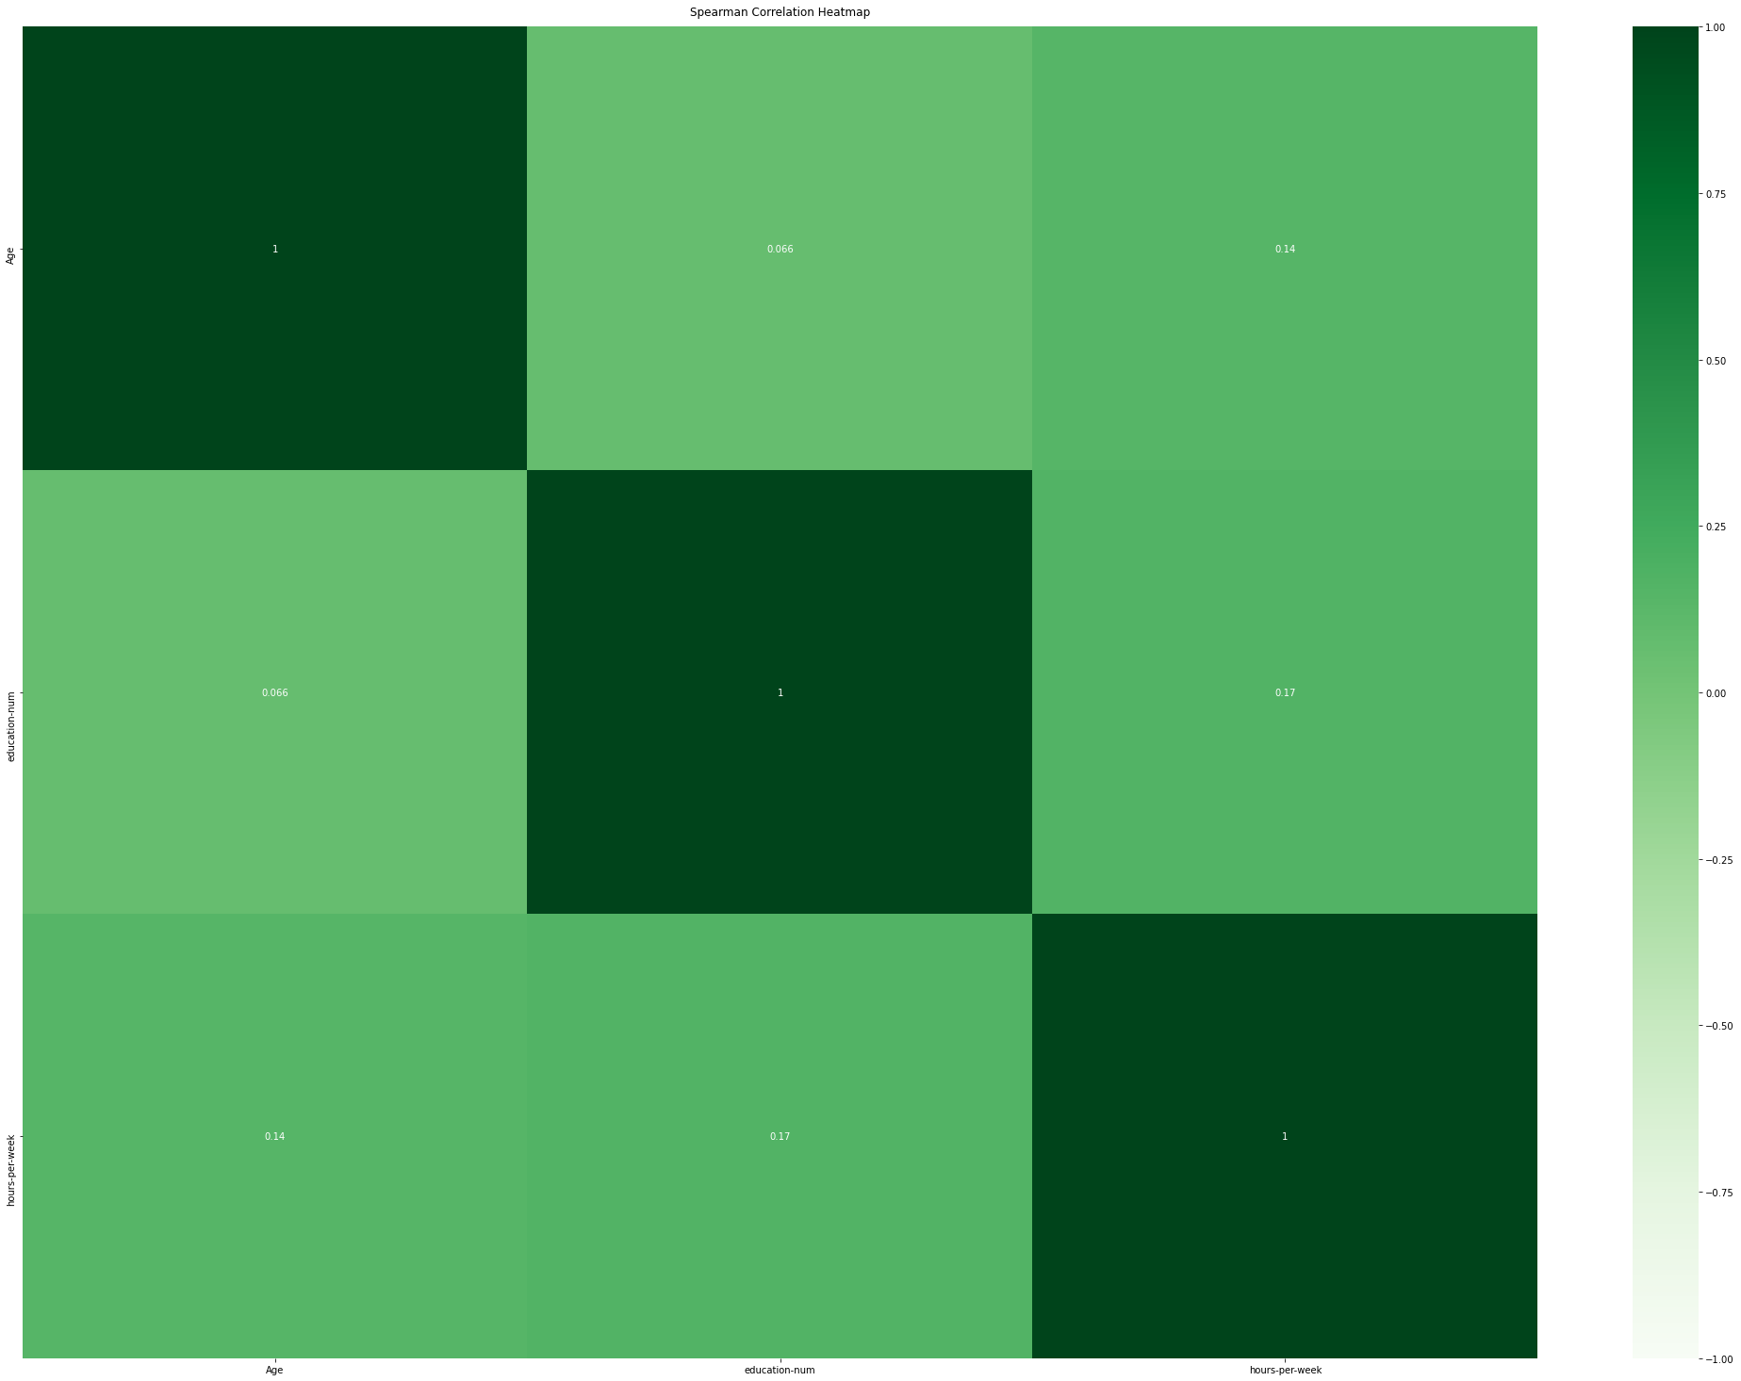
Correlation Analysis
Age
1
0.066
0.34
Spearman correlation analysis
No strong correlation can be observed
Education nbre
0.066
1
0.17
Hours per week
0.34
0.17
1
Age
Education nbre
Hours per week

Slide 14
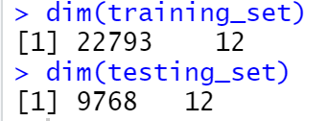
Model 1: Logistic Regression
To predict if an individual person has salary > 50K using the dataset
Response variable: Salary
Predictor variables: 11 variables in the dataset
Education num is numeric representation of education
Capital gain and capital loss are from other investment sources
Models | AIC values
Original Model | 16194
Forward Selection | 16182
Backward selection | 16182
70% in the training dataset

Slide 15
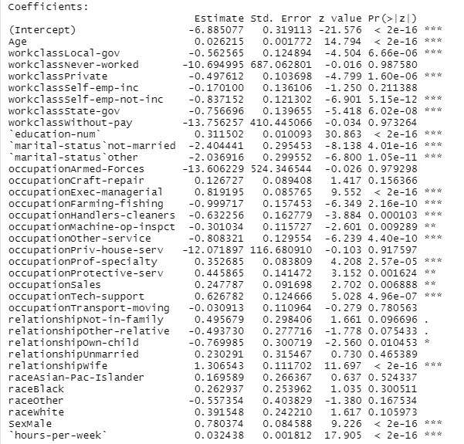
Model 1: Logistic Regression
Parameter estimates
With increased age the probability of making >50k will increase
With increased education number the probability of making >50k will increase
Male has higher probability of making >50k compared to female
Compared to federal gov, local gov has low probability of making >50k
The probability of making >50k increase with the increase of hours per week

Slide 16
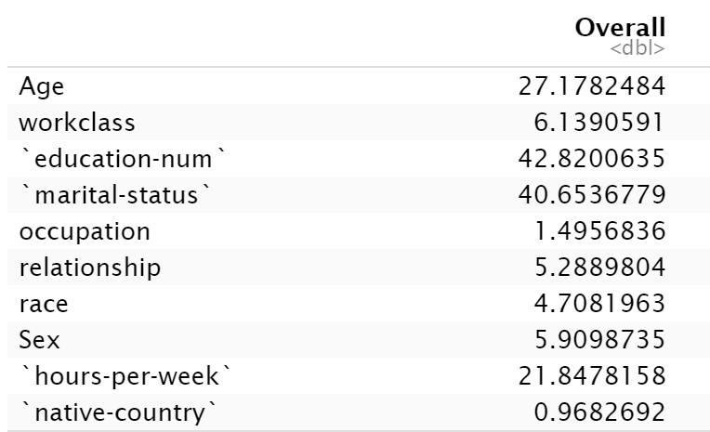
Model 1: Logistic Regression
Education number seems to be most important to predict the probability of making more than 50k annually, followed by
Marital status
Age
Hours per week
Workclass
Sex
Relationship
Race
Occupation
Native country
Importance of the variables

Slide 17
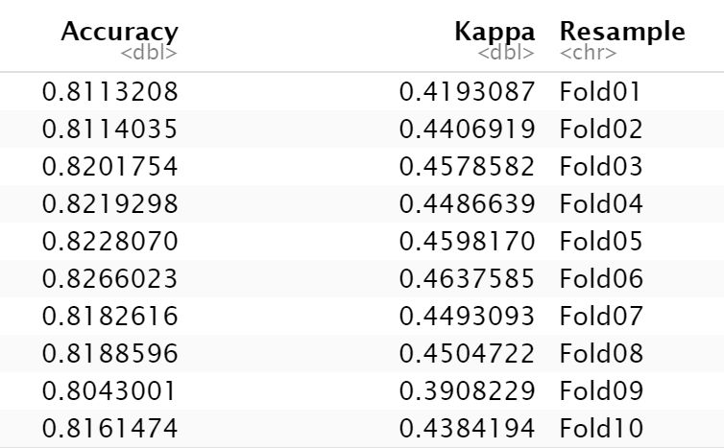
Model 1: Logistic Regression
Model evaluation
Confusion matrix for test data
Using k = 10 in k-fold cross validation, the mean accuracy on training data is 0.817
Actual values
Predicted Values |  | 0 | 1
 | 0 | 6803 | 1046
 | 1 | 561 | 1358
Accuracy on test data: 0.835
For >50k
Precision | 0.708
Recall | 0.565

Slide 18
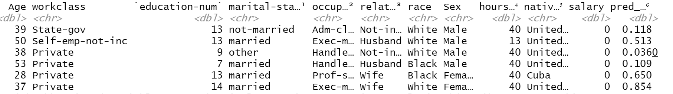
Model 1: Logistic Regression
Predicted probability of making more than 50k annually
Individuals who are married black female and works at private company in Cuba, has around 65% probability of making more than 50k annually.

Slide 19
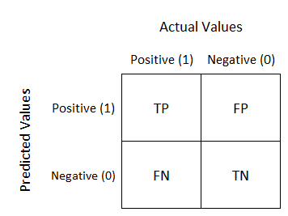
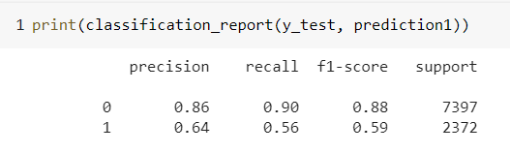
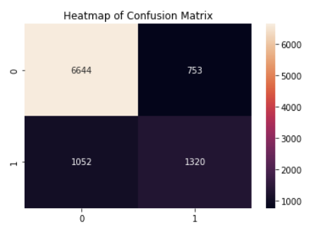
Model 2: Random Forest Classifier
Model evaluation
k-fold cross validation using k = 10
We used GridSearchCV
Avg Train Accuracy for 10 - Fold: 0.823
Accuracy on test data: 0.815

Slide 20
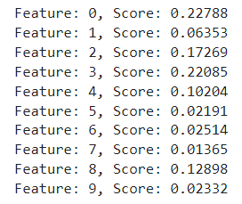
Model 2: Random Forest Classifier
Importance of the variables
Age number seems to be most important to predict the probability of making more than 50k annually, followed by​
Marital Status ​
Education num
Hours per week
Age | workclass | education-num | marital-status | occupation | relationship | race | Sex | hours-per-week | native-country | salary

Slide 21
Model 3: Support Vector Machines
SVMs - binary classification problems.
Kernel methods, kernel functions - transform data features.
Complex datasets - higher dimensions.
Simplification of data boundaries .

Slide 22
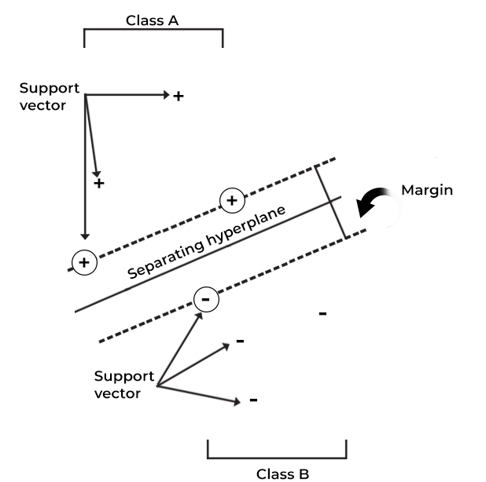
Model 3: Support Vector Machines
https://www.spiceworks.com/tech/big-data/articles/what-is-support-vector-machine/

Slide 23
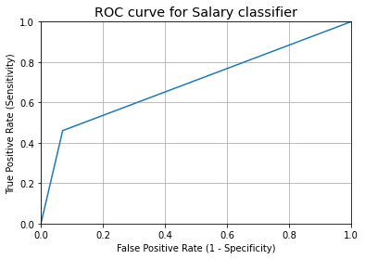
Model 3: Support Vector Machines - Linear
***Evaluation Metrics for testing dataset*** Confusion Matrix: [[6879 518] [1280 1092]] Accuracy Score: 0.8159484082301157 Misclassification Rate (Classification error): 0.18405159176988428 False Positive Rate: 0.07002838988779235 ROC_AUC_SCORE of Predicted Value: 0.6951713025265929

Slide 24
Model 3: Support Vector Machines – Non-linear (RBF)
***Evaluation Metrics for testing dataset*** Confusion Matrix: [[6951 446] [1295 1077]] Accuracy Score: 0.8217831917289384 Misclassification Rate (Classification error): 0.17821680827106157 False Positive Rate: 0.06029471407327295

Slide 25
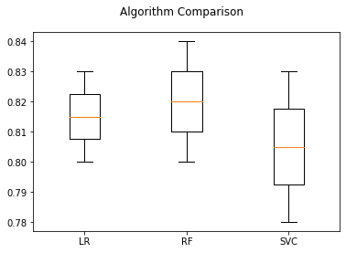
Comparing Three Models
Box Plot comparing the results of models.​
Box Plot comparison of the model clearly tells that Random Forest Classifier fits the data well comparing other models.​
Whisker / Box plot shows the spread of the accuracy range of cross fold validation for three algorithms.​
Logistic Regression has the least spread of accuracy whereas Random Forest classifier and SVC are spread with different set of K Folds.​

Slide 26
Comparing Three Models
Comparing the accuracies of different models are not always perfect to identify the right model or fine tune the model.
In a classifier model, though accuracy is easily readable finding area under roc-curve / auc score is consistent and more discriminative.

Slide 27
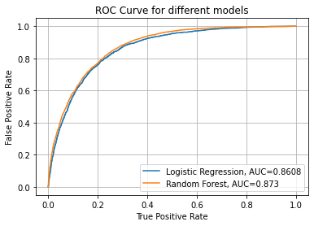
Comparing Three Models
For three of our classifiers, we have plotted the ROC curve and auc scores.​
The auc scores of each model also tells that random forest classifier fits the model better than other two models.​
ROC Curves
ROC_AUC_SCORE : 0.695171

Slide 28
Comparing Three Models
Pros and Cons
Logistics regression is easy to train, implement and interpret
However, it is difficult to establish complex relationship with this predicting method and it is only suitable for linear surface data.
Random Forests work well with large set of data.
It can be used for both classification and regression tasks.
However, Random Forests are not easily interpretable and can be computationally intensive for large datasets. It is expensive for large datasets.
Support vector machine is effective in high dimensional spaces, but it requires higher training time when the dataset is large enough.

Slide 29
Conclusion
Age, education, marital status and hours per week are the four most important variables according to logistic regression and random forest
Random forest classifier has better fit in comparison with logistic regression and support vector machines
Interesting finding
In addition to age, hours per week and education, marital status is also significantly associated with earning more than 50k annually.

Slide 30
References
1. https://archive.ics.uci.edu/ml/datasets/Adult
2. https://glassboxmedicine.com/2019/02/23/measuring-performance-auc-auroc/
3. https://scikit-learn.org/stable/modules/generated/sklearn.model_selection.GridSearchCV.html
4. https://www.geeksforgeeks.org/random-forest-classifier-using-scikit-learn/
5. https://www.geeksforgeeks.org/advantages-and-disadvantages-of-logistic-regression/

Slide 31
Thank you
Questions?

